Slide 1

AstroSage Analysis
ANU JAIN

Slide 2
Problem Statement
AstroSage has received a 1 crore investment and aims to optimize its call center operations.
The goal is:-
•To determine how to allocate this investment to maximize operational efficiency, customer satisfaction, and profitability.
•The Analysis will consider historical call data, performance metrics, and market trends to make informed decisions.

Slide 3
Introduction to AstroSage
AstroSage is a comprehensive online platform for Vedic astrology, offering a wide range of services including personalized horoscopes, consultations with astrologers, and various astrological tools.
It's essentially a one-stop destination for all things related to astrology, providing both free and paid services.
AstroSage is used by many astrologers to create birth charts and match horoscopes.
AstroSage is used by Hindus to make decisions about marriage, opening a business, or moving to a new home .

Slide 4

DATA OVERVIEW
There are 4 different consultation service that Astrosage usually offers.
This dataset enable us to predict and suggest future investments to grow the sales Turnover.
There are total 149 consultants available.
A good dataset is important to understand the operational cost , customer satisfaction and trend in the sales of call center.

Slide 5

METHODOLOGY
Data Cleaning -: Used spreadsheets functions like trim and Removing duplicates for data cleaning.
Data Enrichment -: Added new variables using Date functions for better analysis.
Customer Segmentation -: Used Sorting and Filtering to classify customers based on consultation type.
Used Pivot tables to analyze the performance of consultants over different category type and ratings recieved on basis of consultations from users.
Visualization -: Created interactive dashboard using different charts for detailed view of dataset.

Slide 6
Hourwise Call Distribution
The above graph shows the hour wise call distribution.
660 calls are the most in a single an hour .
The mid-morning hours generally receives more number of calls round the whole day as per the dataset.
This helps in analyzing the calls in a single an hour.

Slide 7
Day-Wise Calls Volume
The above graph shows the Day-wise call distribution.
430 calls is the maximum amount of call received on a single day.
On an average the call center recieves around 250 calls on a daily basis.

Slide 8
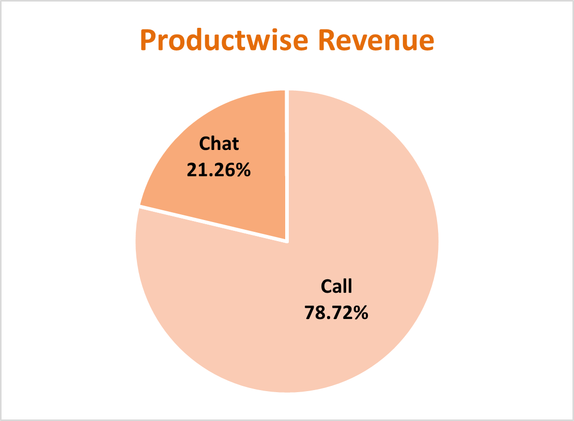
Productwise Revenue
Product-wise revenue Pie Chart , presents a detailed insight about the revenue generated by different consultation-types as per the percentage of total revenue.
Product-wise revenue Pie Chart , presents an impactful insight that the calls consulation are most profitable.
Here, we can observed the profitability.

Slide 9
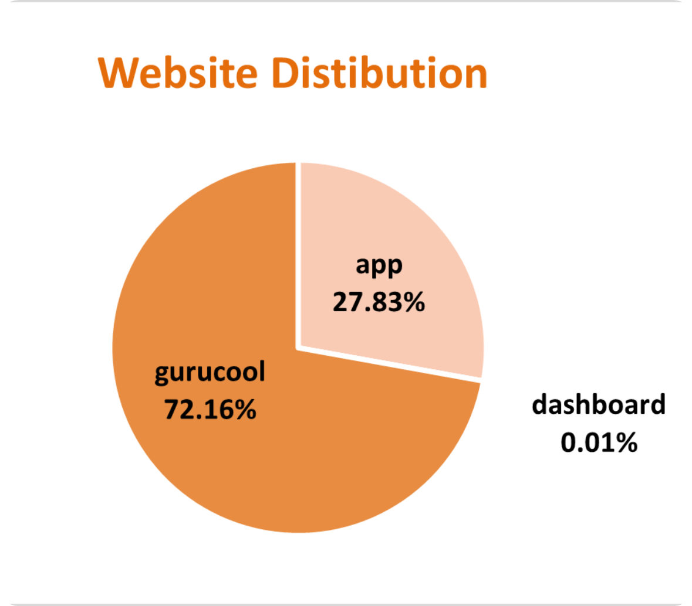
Website Distribution
The website distribution pie chart is presented with the different websites showing count consultations through different website channels.
The most amount consultations are from gurucool.
The least amount of consultations appear from dashboard

Slide 10
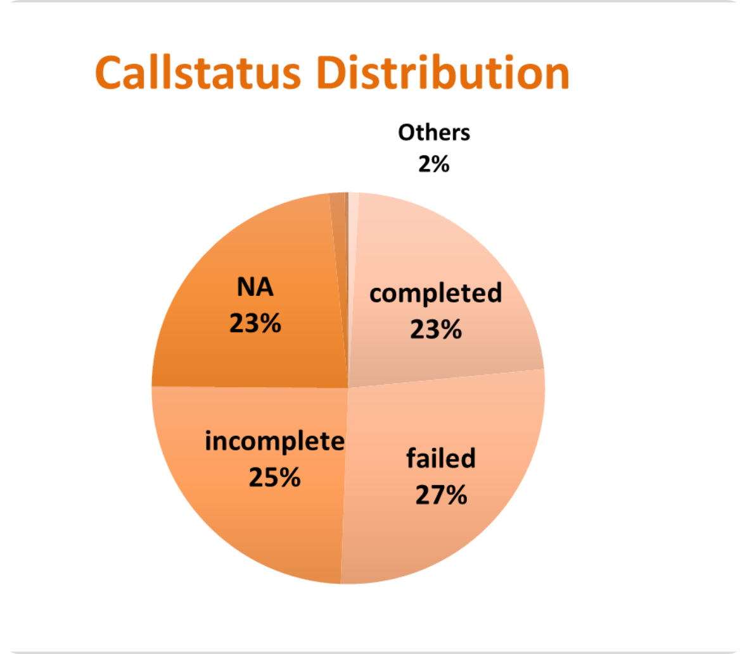
Callstatus Distribution
The call-status pie chart is presented with the different responses by the user i.e. the end result of consultation.
There are the most amount failed calls.
The NA represents the consultations done on any other consultation-type than calls.

Slide 11
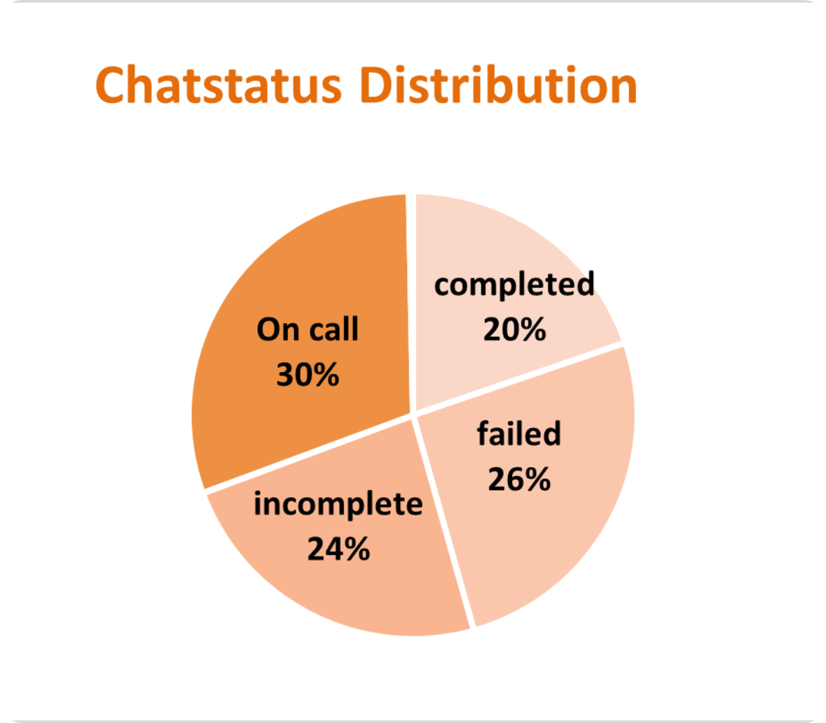
Chatstatus Distribution
The chat-status pie chart is presented with the different responses by the user i.e. the end result of consultation.
The completed chats are 20%
The On call represents the consultations done on any other consultation-type than calls.

Slide 12
Rating Wise Distribution
The column chart represents the rating-wise guru distribution.
The calls consultation needs to be worked on and improve to increase the quality of consultation effectively.
The ratings of Gurus that consulted on chats is better than on calls.

Slide 13
User Wise Rating
The column chart represents the rating-wise user distribution.
The calls consultation needs to be worked on and improve to increase the quality of consultation.
The ratings of users who were consulted on chats is better than on calls.

Slide 14
Top 10 Guru Rating
The column chart represents the Top rated Gurus.
The average rating of the Top 10 Gurus is 5.5.
7.5 is the average highest rating received by the Tarot Mystical and Astro Puja Rai.

Slide 15
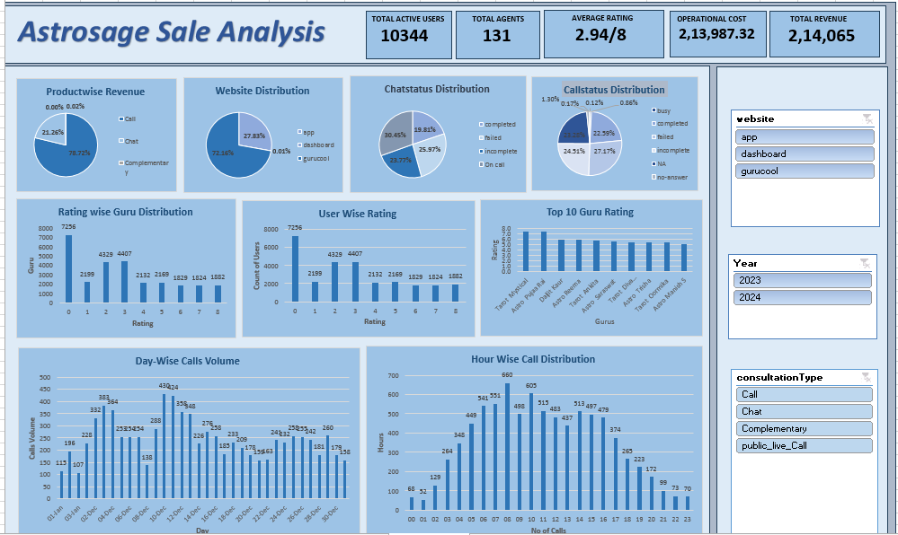

Slide 16

This dashboard includes following metrics:
This dashboard includes following slicers:
Consultation wise Revenue
Callwise & Chatwise Distribution
Website Distribution
Astrologer-wise Distribution
Day and hourwise Calls
Userwise Rating
Top 10 Guruwise Rating
Website
Consultation Type
Months
Years

Slide 17
Strategic Initiatives
Astro-sage should focus upon Technological upgrades to bring customers to the app and dashboard more frequently and decrease the cancelled and failed consultations to improve the profitability.
Astro sage should focus upon the pre-booking model and include CRM Software to assign a particular client to a particular customer to increase customer satisfaction and reduce time lapse and repetitive procedure of intro sessions.
Astro-sage should focus on call consultations to increase the revenue and installs some chatbots and virtual assistant for general chat process instead of consultants to have them available for the peak hours to reduce the operational cost.
Finally, Astro- sage must allow a customer to choose a consultant and take feedbacks of the session. And weekly distribute the most rated and most appreciated astrologer’s session recording to others and organize regular training to stay up to date and keep all the consultants on the same level , to maintain the quality and consistency of the session.

Slide 18

Conclusion & Recommendations
Using chatbots for general queries will lower operational costs and reserve consultants for peak hours.
Upgrading technology and streamlining operations can enhance profitability and customer satisfaction.
Focusing on call consultations can increase revenue and customer engagement.
Introducing pre-booking and CRM systems will improve efficiency and reduce repetitive processes.
Allowing customers to choose consultants and collecting feedback will build trust and loyalty.

